Slide 1
What is Django ?

Slide 2
Toolkit
Components needed for application
development
Focused
Focus on the application's unique features

Slide 3
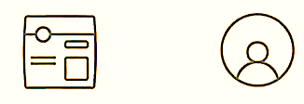

User login and
authentication
Admin
dashboard

Slide 4
Text content
Media files
Heavy traffic
Used widely

Slide 5
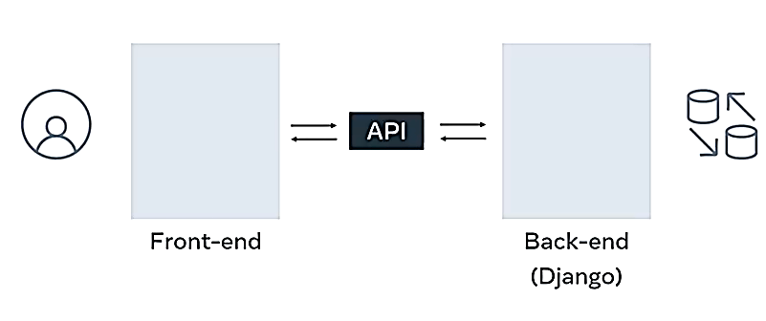
Dynamic website

Slide 6
Dynamic website
Email notifications
Data analysis tools
Admin dashboards
Development tools
Back-end
(Django)

Slide 7
ML and Al
Scalable web apps
SaaS apps
OTT platforms

Slide 8
ML algorithms
APIs RPCs WebSockets

Slide 9
Instagram
Social media app
(Django)

Slide 10
Traffic management
Social media
Magazines
Blogs

Slide 11
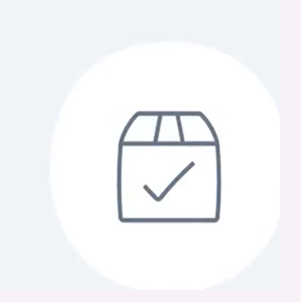
Cloud-storage application
Asynchronous views

Slide 12

Service 1
Service 2
Service 3

Slide 13
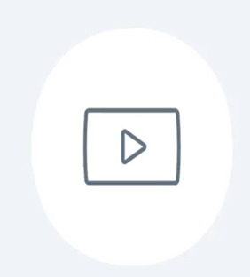
OTT media platforms
Audio and video streaming services

Slide 14
Fault tolerance
Open - source

Slide 15
Adaptable and robust
Supportive community
Documentation
Security

